Slide 1

Application using Different Encryption Methods with Cryptographic Algorithms
presented by:
SUHAS S

Slide 2
CONTENT
ABSTRACT
INTRODUCTION
PROBLEM STATEMENT
LITERATURE SURVEY
REQUIRMENT ANALYSIS
SYSTEM ANALYSIS
DESIGN AND DEVELPMENT
IMPLEMENTATION OF ALGORITHMS
RESULT AND OUTPUT
CONCLUSION
REFERENCES

Slide 3
ABSTRACT
The rise of internet has created a major challenge for securing sensitive information sent over the network. Several solutions have been proposed in the past to protect user data. Encryption algorithm is one of them. At present, various types of encryption algorithms like AES, DES, RSA and others are available. In this report, we have proposed an algorithm for ourselves which is 128-bit text size and 128-bit key size.
We have compared the proposed algorithm with different algorithm comparisons. The result is showing our proposed algorithm gives better performance.
By the difference we see that our recommended encryption process's average runtime is 0.006 sec which is less than other algorithms (AES, DES). It also protects various cryptanalytic attacks - key attack, brute force attack, man in the middle attack and it is also suitable for the implementation of software and hardware.

Slide 4
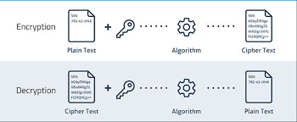
INTRODUCTION
Encryption is the process of encoding all user data or information using symmetric or asymmetric key in such a way that even if an unauthorized party tries to access the data without keys, they won’t be able to read it.
Decryption is the reverse process of encryption. It is the process of decoding all encrypted data using symmetric or asymmetric key in such a way that only authorized parties can access the data and can read it.
Data Encryption Standard (DES) is a symmetric key block cipher. In DES the key length is 112 bits or 168 bits and block size is 64-bits length. Now a day the increasing computational power is available which makes DES weak. For this reason, it can be attack by Brute Force Attacks other cryptanalytic attacks. In triple DES algorithm the size of block and key increased.

Slide 5
PROBLEM STATEMENT
The importance of protecting sensitive information on an Android platform. A reliable security
system is an absolute necessity in light of the growing likelihood that sensitive information will be
compromised or that unauthorized users will gain access to it. The goal of this project is to design an
algorithm that protects the secrecy of data and thwarts cryptanalytic assaults like key attacks and
brute force attacks. The expanding sense of urgency regarding safety issues and the critical nature of
preventing unauthorized access to sensitive information are the driving forces behind the need for this
research.

Slide 6
LITERATURE SURVEY
Rayarikar Rohan, Upadhyay Sanket, Pimpale Priyanka 2012 have built up an application on android stage which enables the client to encode the messages before it is transmitted over the WAN network. They have utilized the propelled encryption standard (AES) calculation for encryption and unscrambling of the information. Their application can keep running on any gadget which takes a shot at android stage. This application gives a safe, quick and solid encryption of the information
Buba P.Z, Wajiga G.M in 2011 presented new cryptographic algorithms that employ the use of asymmetric keys. The proposed algorithm decode message into nonlinear conditions utilizing open key and unravel by the expected party utilizing private key. In the event that an outsider caught the message, it will be hard to decode it dew to the staggered figures of the proposed application.

Slide 7
REQUIREMENT ANALYSIS
HARDWARE REQUIREMENTS
• 64-bit Microsoft® Windows® 8/10/11:
• x86_64 CPU architecture; 2nd generation Intel Core or newer, or AMD CPU with support for
a Windows Hypervisor.
• 8 GB RAM or more.
• 8 GB of available disk space minimum (IDE + Android SDK + Android Emulator)
• 1280 x 800 minimum screen resolution

Slide 8
SOFTWARE REQUIREMENTS
Android studio version electric Eel
In Android Studio Electric Eel, the new version of Logcat is enabled by default to make it easier to
parse, query, and keep track of logs. This represents the most significant update to the tool since its
introduction.
Google pixel Android Emulator
A google pixel emulator simulates the functions of a Google Pixel device on the developer or tester's
computer. This enables them to test an application on multiple google pixel devices without accessing
each physical device.
SDK (Software Development Kit)
SDK is the acronym for “Software Development Kit”. The SDK brings together a group of tools that
enable the programming of mobile applications.This set of tools can be divided into 3 categories:
SDKs for programming or operating system environments (iOS, Android, etc.), Application
maintenance SDKs, Marketing and advertising SDKs
Gradle for Simulation
Android Studio uses Gradle, an advanced build toolkit, to automate and manage the build process
while letting you define flexible, custom build configurations.

Slide 9
SYSTEM ANALYSIS
Functional Requirements:
1. User Authentication: To guarantee that only authorized users may access the encrypted
data, the system must offer a secure user authentication process.
2. Data Encryption: To protect user data confidentiality, the system must use reliable
symmetric and asymmetric encryption techniques.
3. Data Decryption: The system must enable the decryption of encrypted data using the
proper keys, enabling authorised parties to obtain and see the original data.
4. Performance and Efficiency: The system should be built to perform encryption and
decryption operations quickly, with the least amount of processing overhead and best
system performance.

Slide 10
Non-functional Requirements:
The following non-functional requirements need to be met for the game to be user- friendly and
enjoyable:
1. User Interface: The app has a responsive user interface that works well on different screen
sizes and resolutions.
2. Stability: The app is made stable and reliable, with no crashes or glitches.
3. Responsiveness: The game is fast and responsive, with no noticeable lag or delay when using
4. Visual Appeal: The game is visually appealing, with an attractive design and appropriate
graphics.

Slide 11
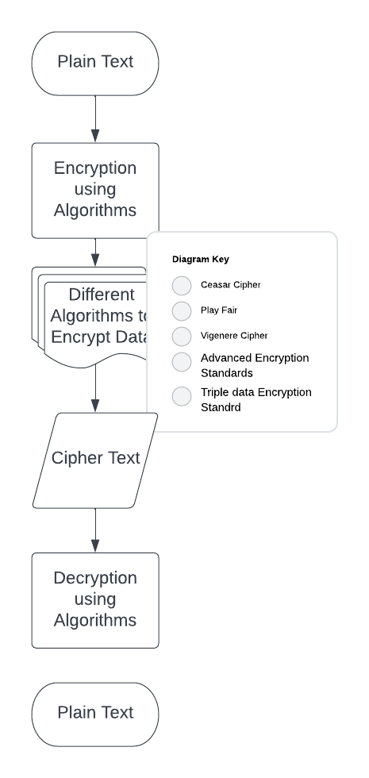
DESIGN AND DEVELOPMENT

Slide 12

ENCRYPTION AND DECRYPTION CIPHER
Plain Text
Encryption
Algorithm
Cipher Text
Decryption
Algorithm
Plain Text
Key A
Key B

Slide 13
IMPLEMENTATION OF ALGORITHMS
AES algorithm
The Advanced Encryption Standard (AES) is a symmetric encryption algorithm that has become the most widely used and accepted encryption standard worldwide. It was selected by the National Institute of Standards and Technology (NIST) in 2001 to replace the aging Data Encryption Standard (DES). AES provides a high level of security while maintaining efficiency and versatility.
Caesar cipher algorithm
The Caesar cipher is one of the simplest and earliest known encryption techniques. It is a substitution cipher where each letter in the plaintext is shifted a certain number of positions down the alphabet to create the ciphertext.
The Caesar cipher is a basic encryption technique and is not suitable for securing sensitive information. However, it serves as a starting point to understand fundamental concepts in cryptography and lays the foundation for more advanced encryption algorithms.

Slide 14
DES algorithm
The Data Encryption Standard (DES) is a symmetric encryption algorithm that was widely used in the 1970s and 1980s. DES is considered less secure by today's standards, it played a significant role in the history of cryptography and served as the foundation for more advanced encryption algorithms.
To enhance the security of DES, Triple DES (3DES) was introduced. It applies DES encryption three times using different keys. This process significantly increases the effective key length and provides stronger security compared to single DES.
Playfair ceipher
The Playfair cipher is a symmetric encryption technique that operates on pairs of letters, making it a digraph substitution cipher.The Playfair cipher offers improved security compared to monoalphabetic ciphers, as it breaks the simple pattern of one-to-one letter substitution.

Slide 15
Vigener cipher
The Vigenère cipher is a polyalphabetic substitution cipher that provides a higher level of security compared to simple substitution ciphers.The Vigenère cipher extends the concept of the Caesar cipher by using multiple Caesar ciphers with different shift values based on a keyword.

Slide 16
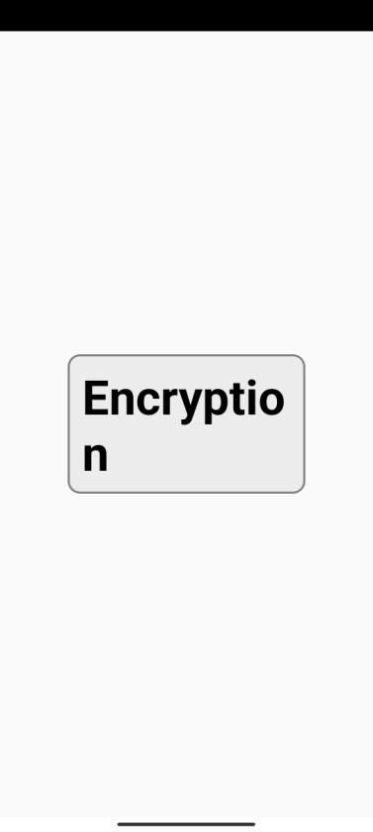
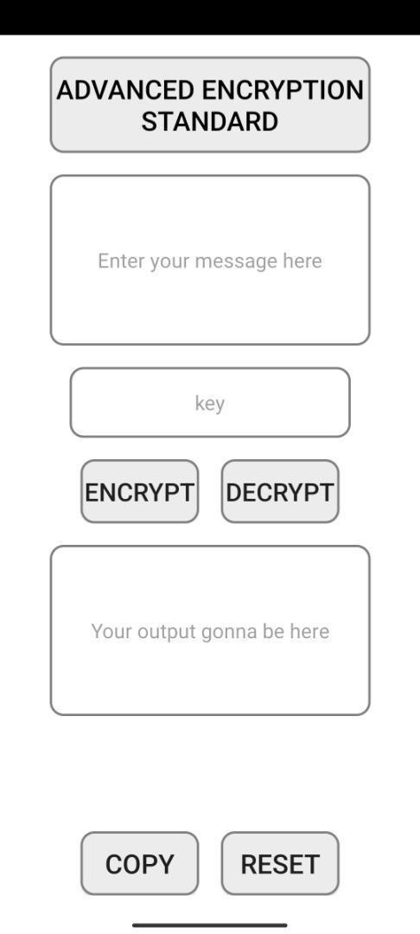
RESULT
Main Page
Advanced encryption Standard Fragment

Slide 17
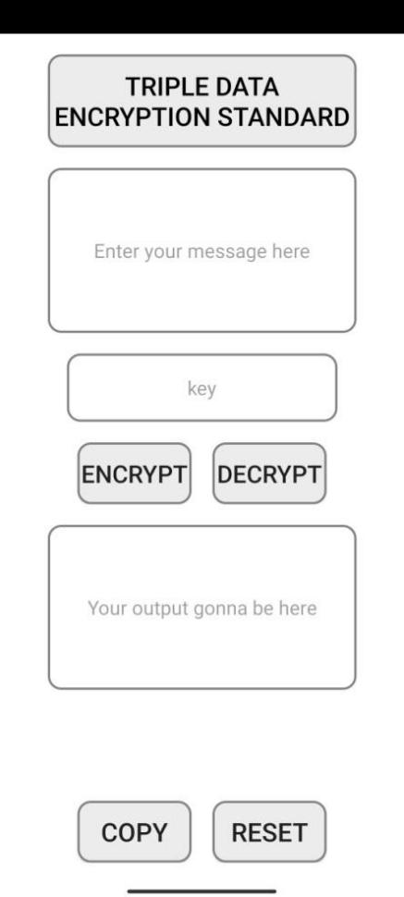
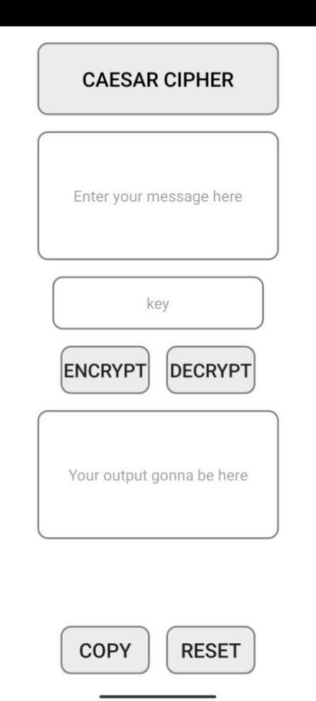
Triple data Encryption Standard
Caesar Cipher

Slide 18
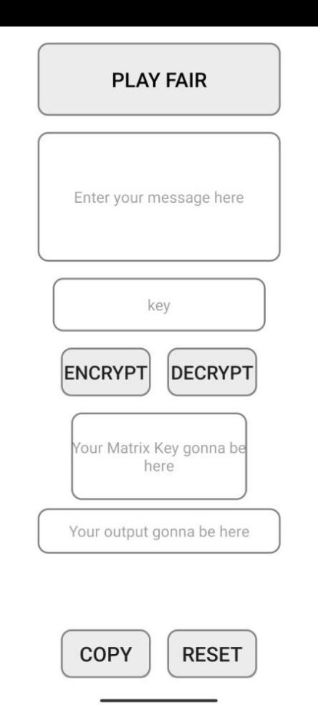
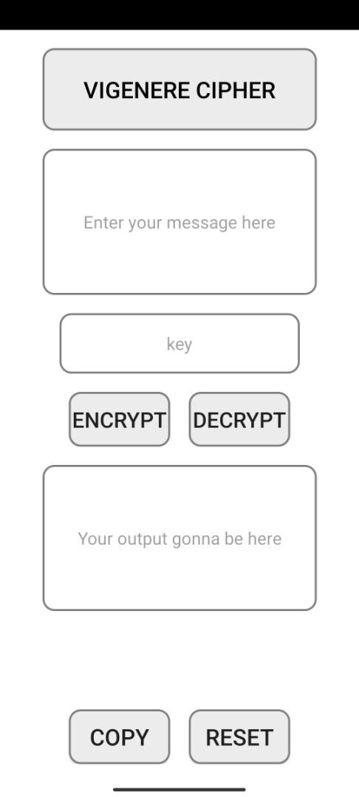
PlayFair Cipher
Vigenere Cipher

Slide 19
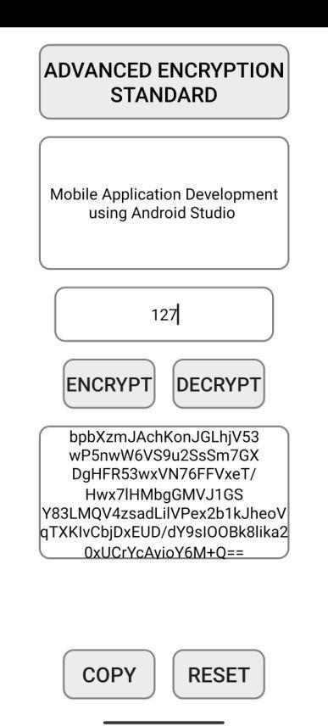
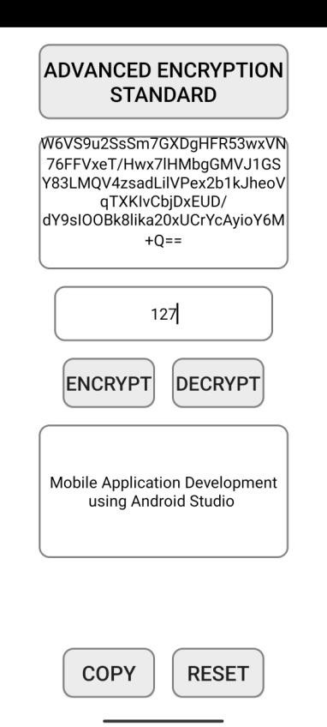
Advance Encryption Standard With Ciphertext
Advance Decryption Standard With Plaintext

Slide 20
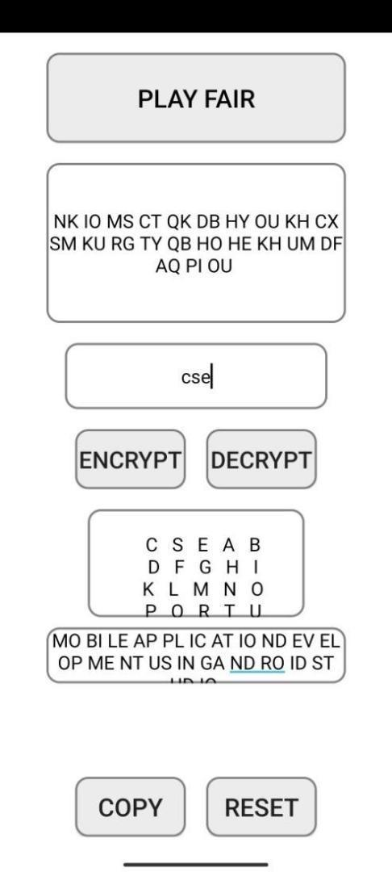
PlayFair Cipher With Encrypted Data

Slide 21
CONCLUSION
The main purpose of our proposed algorithm is to secure any message or information without any loss of data. For this reason, it requires to provide some feature for senders and receivers. These features are known as cryptographic goal. These goals are – confidentiality, integrity, authentication and non-repudiation of data. We have tried to achieve all the goals of the cryptography in our algorithm. In this algorithm we have used symmetric key encryption which is private key based encryption. We have created an algorithm which basically works on block wise where every block can store 128-bit data. After various analyses we found that, it is very strong in terms of security and the speed.

Slide 22
REFERENCES
https://medium.com/@dev.jeevanyohan/basic-encryption-decryption-in-android-aes-72fd3f06ab4c
https://www.androprogrammer.com/2016/04/data-encryption-and-decryption-in.html
https://developer.android.com/reference/javax/crypto/Cipher

Slide 23


